Slide 1
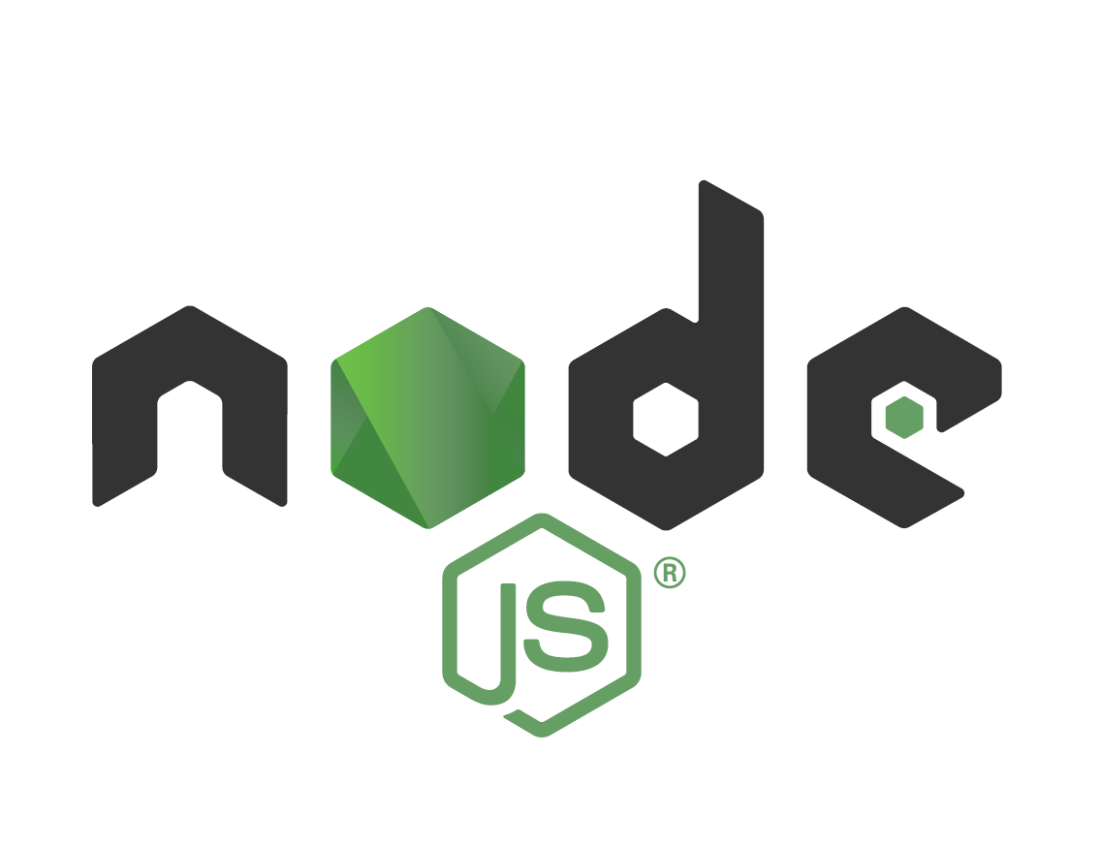
Developing with Node.js
By Caleb Trachte
Source: The Complete Node.js Developer Course (3rd Ed.) – Udemy.com

Slide 2
What is Node.js?
A JavaScript runtime environment built on Google Chrome’s V8 Engine
Uses Event-Driven, Non-blocking Input/output
Non-blocking/Event-driven - process of using callbacks and async
Blocking processes stop the browser every time input is needed
Lightweight/Efficient
Utilizes the NPM ecosystem of open source Libraries

Slide 3
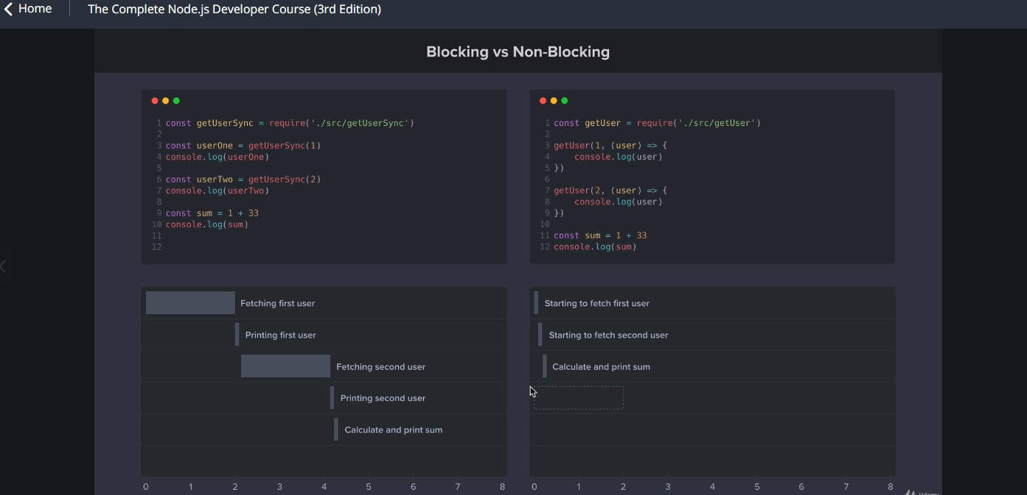
Why Node.js?

Slide 4
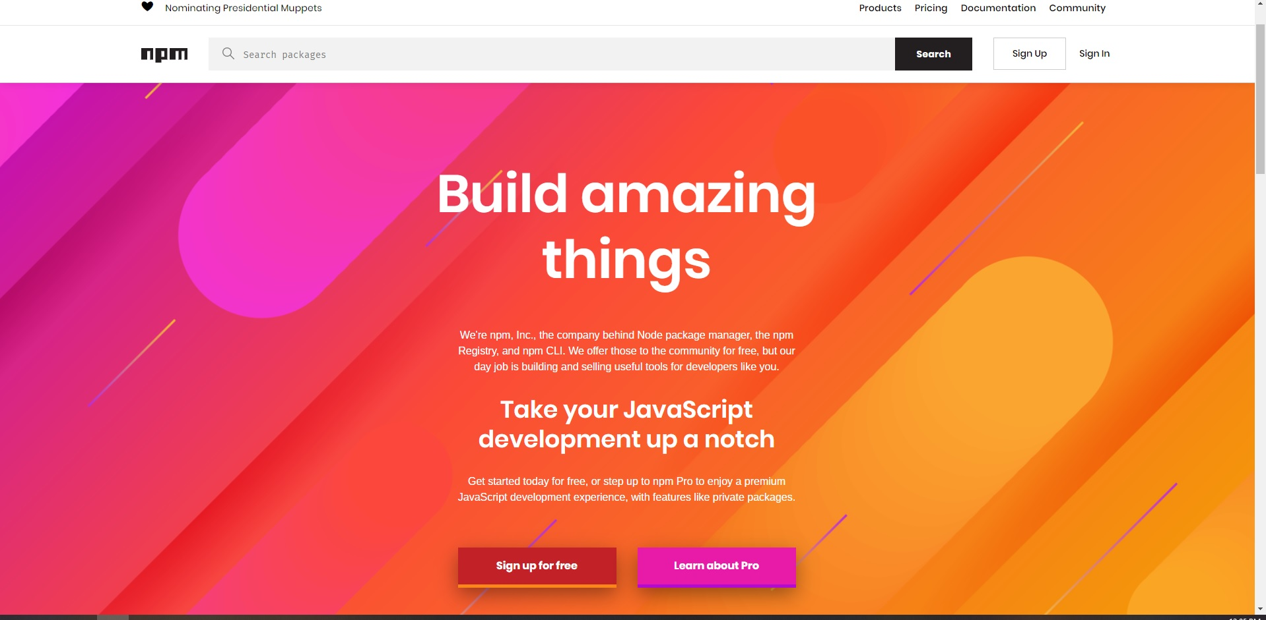
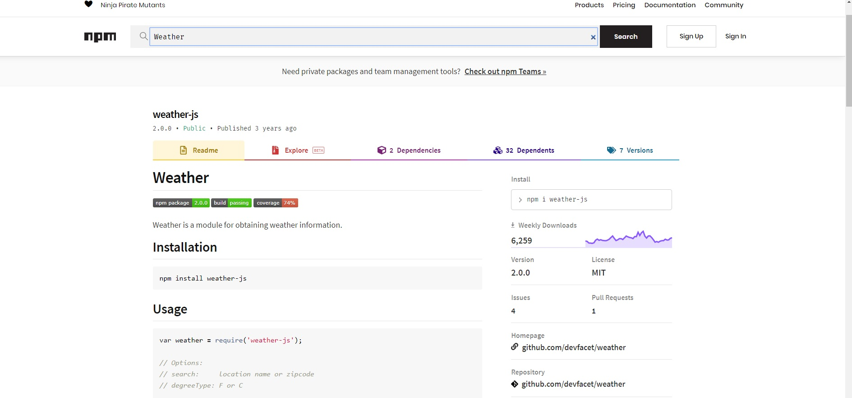
Why Node.js?

Slide 5
Getting Started with Node.js is Easy!
Go to Nodejs.org then download and install the latest version
Now you have access to the node environment in any project!
Include NPM.js in any new project by using `npm init` command
Creates a package.json that contains config information
Use the command `npm install [package-name]` to install packages

Slide 6
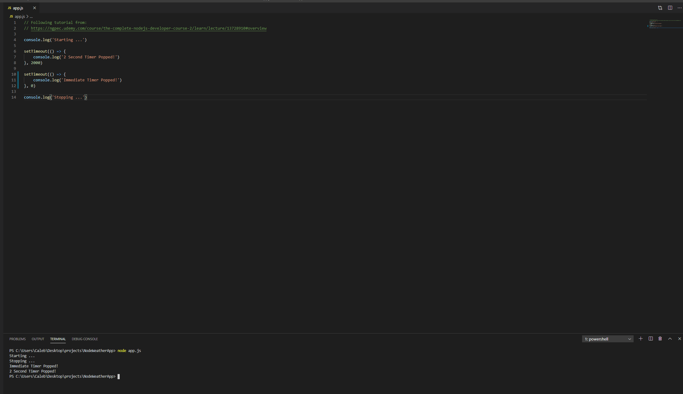
Digging into Asynchronous Node.js
Notice the order of operations …
Not what we expect. Why does this happen?
- Node uses other threads in C++ to run asynchronous code in the background while continuing through each function call in the call stack.
- Callback functions within the functions called, are added to an Event Loop. When the stack is empty, those callback functions are added to the main stack to be executed.

